Slide 1
Java applet
Java programing

Slide 2
Introduction
Java applet is the program which run inside the java compatible container such as web browser or AppletViewer. Applet can be embedded in HTML page and download over the internet. Applet code is refresh automatically when the user visit the hosted website.

Slide 3
Java program vs java applet
Java Application: Java Application is just like a Java program that runs on an underlying operating system with the support of a virtual machine. It is also known as an application program. The graphical user interface is not necessary to execute the java applications, it can be run with or without it.
Java Applet: An applet is a Java program that can be embedded into a web page. It runs inside the web browser and works at client side. An applet is embedded in an HTML page using the APPLET or OBJECT tag and hosted on a web server. Applets are used to make the web site more dynamic and entertaining.

Slide 4
Applet life cycle
Init() method
Start() method
Paint() method
Stop() method()
Destroy() method()

Slide 5
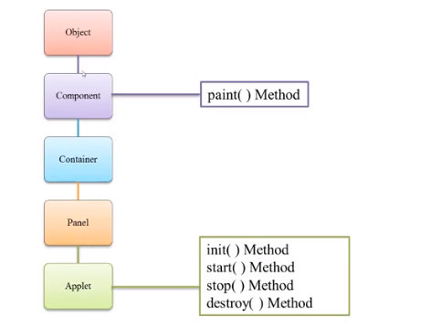
Applet Hierarchy

Slide 6
Basic program
// A Hello World Applet
// Save file as HelloWorld.java
import java.applet.Applet;
import java.awt.Graphics;
// HelloWorld class extends Applet
public class HelloWorld extends Applet
{
// Overriding paint() method
@Override
public void paint(Graphics g)
{
g.drawString("Hello World", 20, 20);
}
}

